Slide 1
IoT Based Multi-Purpose Unmanned Surface Vehicles for Surveillance and Rescue Operations
Presented By :
Brishti Sarkar
Shreya Banik
Somdatta Das

Slide 2
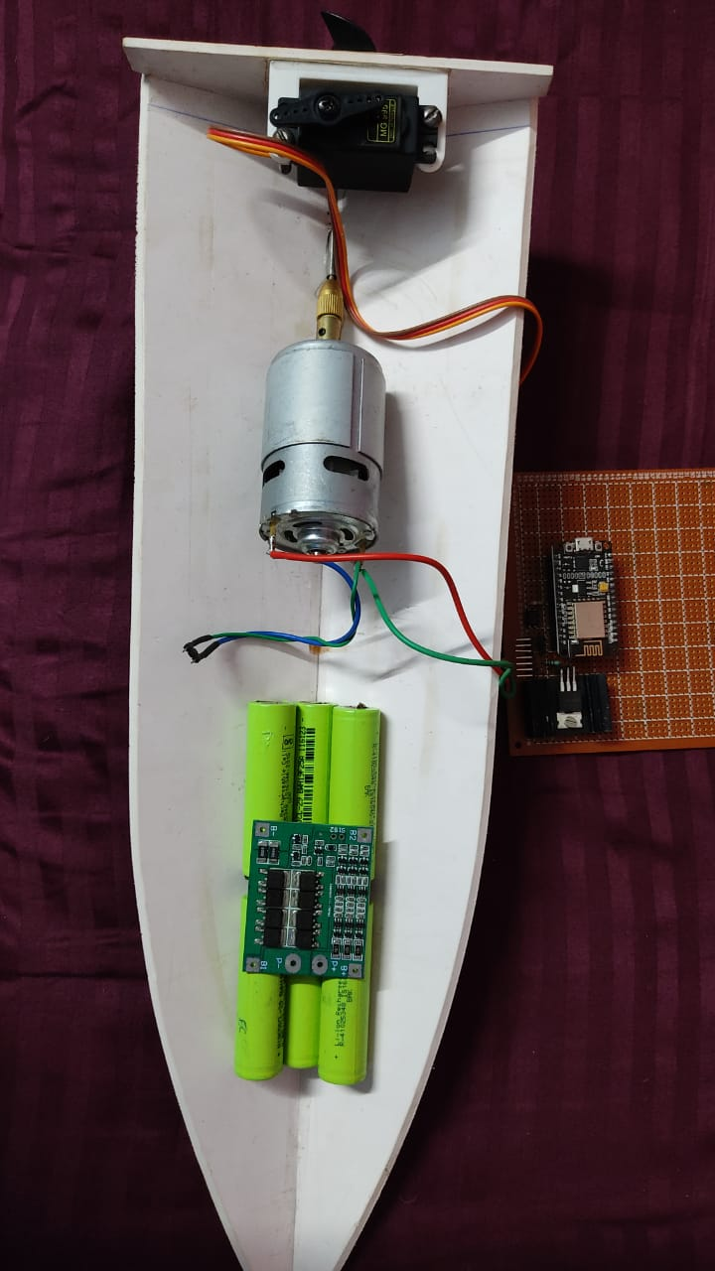

Slide 3
Need of the project :
Disaster robotics has become a research area in its own right .Most of these disaster deployments use aerial, ground, or underwater robotic platforms.However, the research involving autonomous boats or Unmanned Surface Vehicles (USVs) for Disaster Management (DM) is currently spread across several publications .Our project attempts to explore the possibility of designing and implementing an Unmanned Surface Vehicle (USV) in form of a Boat with a Surveillance Camera installed for search and rescue operations at Water bodies. This USV can be controlled over the internet using concepts of Internet of Things.

Slide 4
Content :
1. Introduction 2. Literature survey
And related works
3. Proposed system 4. Block diagram
5. Flow chart 6. Hardware description
7. Software requirement 8. Internet of Things
9. Circuit & Simulation 10. Advantages
11. Applications 12. Future Scope
13. Conclusion 14. Acknowledgement
15. References

Slide 5
Introduction:
1. India’s long coastline presents a variety of security challenges including illegal landing of arms and explosives at isolated spots on the coast, infiltration/ex-filtration of antinational elements, use of the sea and off shore islands for criminal activities, and smuggling of consumer and intermediate goods through sea routes.
2.FICCI believes that industry has the technological capability to implement border management solutions.
3.It is very critical to perform search and rescue operations on sea and large waterbodies. In such cases such Unmanned Robots can help speed-up the Search and rescue process and also reduce the resource expenditure.
4.Purpose of this project: This project “Multi-Purpose Unmanned Surface Vehicles for Surveillance and Rescue Operations” using domain of Internet of Things (IoT) is used mainly in Defense and Rescue purpose. This will help provide better security and surveillance capabilities to our Sea borders and restrict unauthorized infiltration attempts. It may also be used to save lives in case of a natural disaster.

Slide 6
Literature Survey and Related Works :
In the literature survey conducted, there are different approaches developed for Unmanned Surface Vehicle. A great part of maritime unmanned systems developed did not target such application, being more focused on environmental monitoring, surveillance or defense.In opposition to these applications, search and rescue operations need to take into account relevant issues such as the presence of people or other vessels on the water.

Slide 7
Proposed system :
The design of this Unmanned Surface Vehicle resembles that of a Speed Boat. The boat has a high-power DC motor coupled with a propeller to provide thrust. The direction of this thrust vector is controlled by a rudder. The rudder is rotated at a specific angle based on the signals provided by the main microcontroller board with the help of a servo motor. The power system of this USV consists of a pack of Li-Ion batteries . There is also an array of solar panels responsible for charging the batteries and provide long duration.

Slide 8
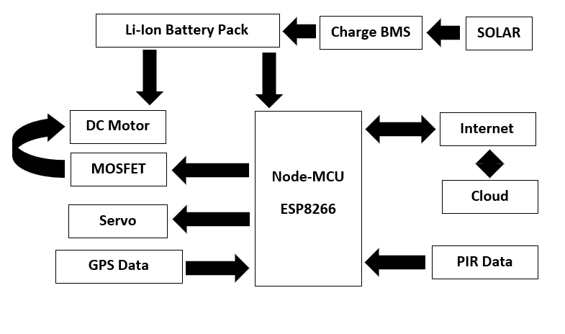
Block Diagram :

Slide 9
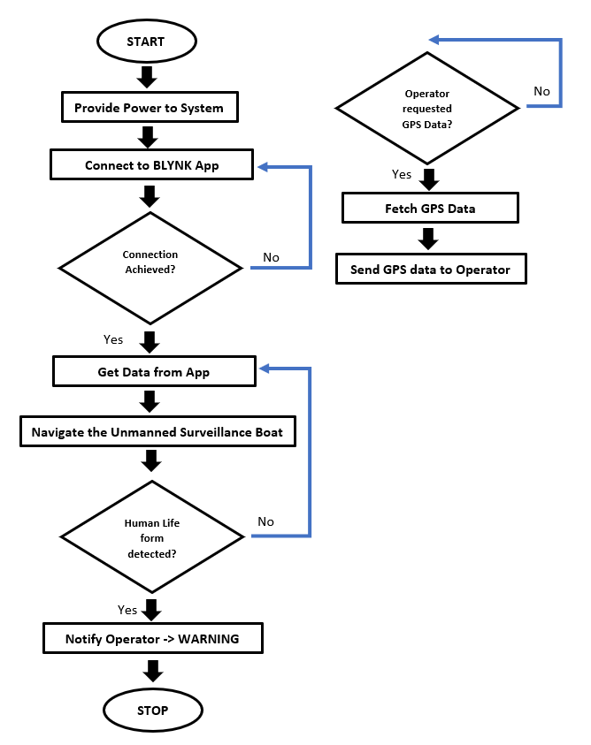
Flow Chart:

Slide 10
Hardware Description:
The hardware components of this USV platform that can be used for multiple purpose consists of – NodeMCU as the main control system, a DC Motor as the main Actuator, Servo as the navigation Rudder control, MOSFET to provide PWM signal to DC Motor to control speed, PIR or Passive Infrared Sensor as Human Lifeform detector, 18650 Li-Ion Cells as power supply.
1. Arduino Board: Arduino is a hardware source platform. The Software of Arduino uses a simplified version of C++ . Atmega328 is the microcontroller used in Arduino. It is low power and high-performance microcontroller used to read and control the data from sensors.
2. NodeMCU ESP8266 12E: The NodeMCU-ESP8266 is a microcontroller is an open source IOT platform with Wi-Fi capability. It allows microcontrollers to connect to a Wi-Fi network and make simple TCP/IP connections using Hayes-style commands.
3. Passive Infrared Sensor PIR: PIR sensors allow you to sense motion, almost always used to detect whether a human has moved in or out of the sensors range.
4. Li-ion 18650 Cell: An 18650 battery is a cell that's 18mm x 65mm in size. Nominal Voltage: 3.6V

Slide 11
Hardware Description:
5. Battery Management Circuit : 3S 11.1V 10A 18650 Lithium Battery Overcharge and Over-current Protection board ensures the security of battery pack. This battery management system design and Suitable for: 10.8V, 11.1V, 12.6V . Features: • Three series of lithium battery protection board. • Automatically cancel protection after protection conditions restore. • With the function of overcharge protection, over discharge protection, short circuit protection, over-current protection.
6. MOSFET : A MOSFET is a semiconductor device that can be used as a solid-state switch. These are useful for controlling loads that draw more current, or require higher voltage. In their off state MOSFETs are non-conducting, while in there on state, they have an extremely low resistance - often measured in milliohms. MOSFETs can only be used to switch DC loads.
7. DC Motor: A DC motor may be an automatically commutated motor steam-powered from DC . A current-carrying conductor generates a field; once this can be then placed in associate degree external magnetic field, It'll expertise a force proportional to the present within the conductor, and to the strength of the external field.

Slide 12
Hardware Description :
8. Servo Motor : Servo is a general term for a closed loop control system which uses the feedback signal to adjust the speed and direction of the motor to achieve the desired result. RC servo motor works on the same principal. It contains a small DC motor connected to the output shaft through the gears. The output shaft drives a servo arm and is also connected to a potentiometer (pot).
9. Power Supply : The ac voltage, typically 220V rms, is connected to a transformer, which steps that ac voltage down to the level of the desired dc output. A diode rectifier then provides a full-wave rectified voltage that is initially filtered by a simple capacitor filter to produce a dc voltage. This resulting dc voltage usually has some ripple or ac voltage variation. A regulator circuit removes the ripples and also remains the same dc value even if the input dc voltage varies, or the load connected to the output dc voltage changes. This voltage regulation is usually obtained using one of the popular voltage regulator IC units.

Slide 13
Software Requirement :
Blynk:
Blynk was designed for the Internet of Things. It can control hardware remotely, display sensor data, store data, visualize it and do many other cool things. There are three major components in the platform:
• Blynk App - allows to you create amazing interfaces for your projects using various widgets we provide.
• Blynk Server - responsible for all the communications between the smartphone and hardware. You can use our Blynk Cloud or run your private Blynk server locally. It’s open-source, could easily handle thousands of devices and can even be launched on a Raspberry Pi.
• Blynk Libraries - For all the popular hardware platforms - enable communication with the server and process all the incoming and outcoming commands.

Slide 14
Internet of Things (IoT) :
IoT is an ecosystem of connected physical objects that are accessible through the internet. All interconnected over public or private Internet Protocol (IP) networks. It is also referred to as Machine-to-Machine (M2M), Skynet or Internet of Everything The IOT concept was coined by a member of the Radio Frequency Identification (RFID) development community in 1999.
Internet of things is an internet of three things: (1). People to people, (2) People to machine /things, (3) Things /machine to things /machine, Interacting through internet. Connectivity: Connectivity enables network accessibility and compatibility. Accessibility is getting on a network while compatibility provides the common ability to consume and produce data.

Slide 15
Advantages of IOT :
Access information- You can easily access data and information that is sitting far from your location, in real time.
Communication - Better communication is possible over a network of interconnected devices.
Cost-effective -Transferring data packets over a connected network save time and money .
Automation - Automation is the need of the hour to manage everyday tasks without human intervention.

Slide 16
Disadvantages of IOT :
Privacy & security -In today’s tech-driven world, each and every device that an individual uses is connected via the internet. This increases the risk of any leakage of data that might be important.
Complexity - A diverse network that connects various devices is what we call IoT. A single loophole can affect the entire system.
Lesser jobs -With every task being automated, the need for human labor will reduce drastically.
Dependability - We may not notice it, but we are witnessing a major shift in technology .

Slide 17
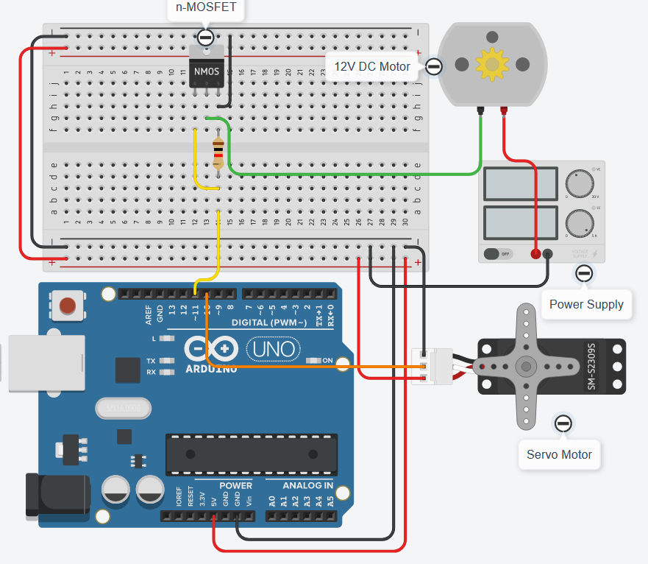
Circuit & Simulation:

Slide 18
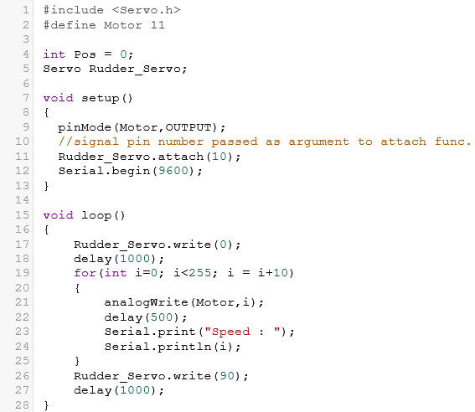
Coding :

Slide 19
Advantages:
The IOT based Unmanned Surface Vehicle (USV) can be used to do surveillance purpose, rescue purpose with very easily through a smartphone app with trivial amount of life risk.
The solar panel used here also help us make this vehicle run on green energy . The cost of battery or need for long-lasting battery are redundant and it’s been made to be more eco-friendly.
A night vision camera or video image processor can be mounted on top of this vehicle making it efficient for rescue purpose or surveillance during night time.
It can be used for seaweed farming. Using USV helps in reducing the operation cost to a great extent.
Being equipped with PIR sensors which will help us in warning about unauthorized movement if any. Thus, can be used for surveillance in places that are hard to keep an eye on like a maritime border.
The system can send us weather data which can help us know about the weather in parts where it’s stationed.
This system being entirely IOT based, any function that we want to perform can be done without any human-machine interaction. Thus, it’s risk free and the amount of work needed is very trivial.
If used in defense purpose, the data protection and privacy issues can also be dealt with. The data stored in the cloud can be manipulated, made copy of, encrypted and backed up as per our need.

Slide 20
Application:
defense
search and rescue.
Scientific research

Slide 21
Future Scope:
The system can be integrated with GPRS / GSM modules for notifying the higher authorities by Text Messages for Rapid Action. The system can also get a Wi-Fi module for real time tracking of Offenders. And the coordinates can be sent via Text Message to the respective Authorities in charge.

Slide 22
References:
Wikipedia
Thedigitalship.com
www.arduino.cc
www.researchgate.net

Slide 23
Thank You Everyone!

